Slide 1
React
Middleware

Slide 2
Agenda
React-redux "connect"
Redux Thunk
redux-saga
Put all together
Testing where has to be a place?

Slide 3
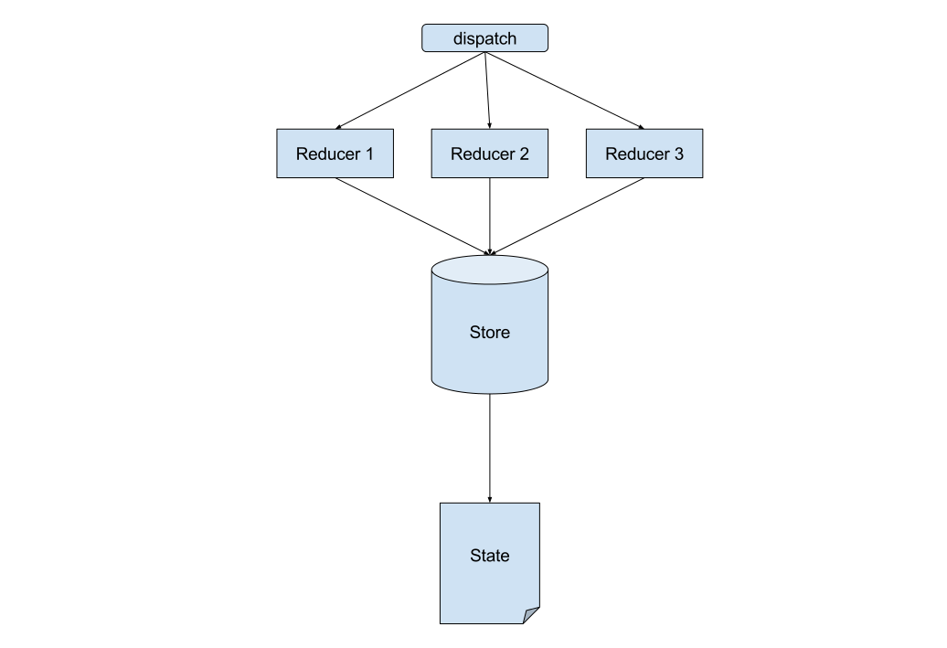
React and redux on their own

Slide 4
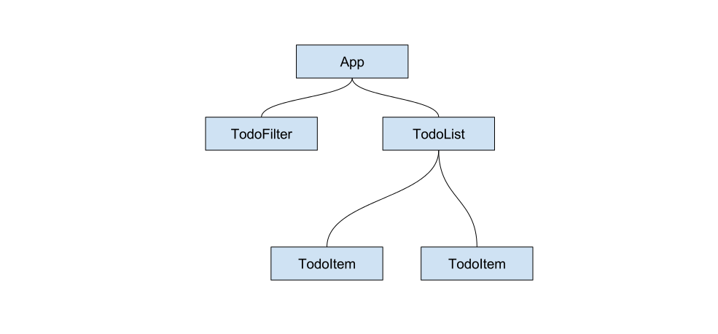
Component structure

Slide 5
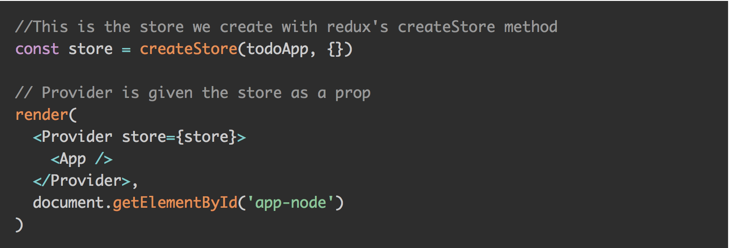
Putting them together

Slide 6
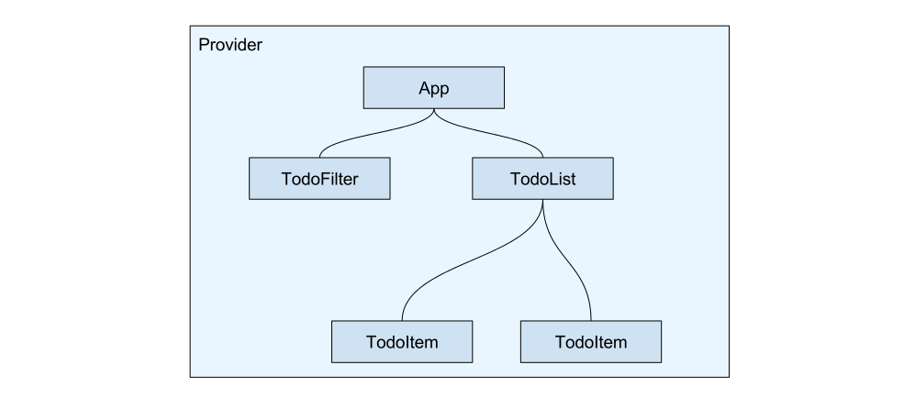
Provider

Slide 7
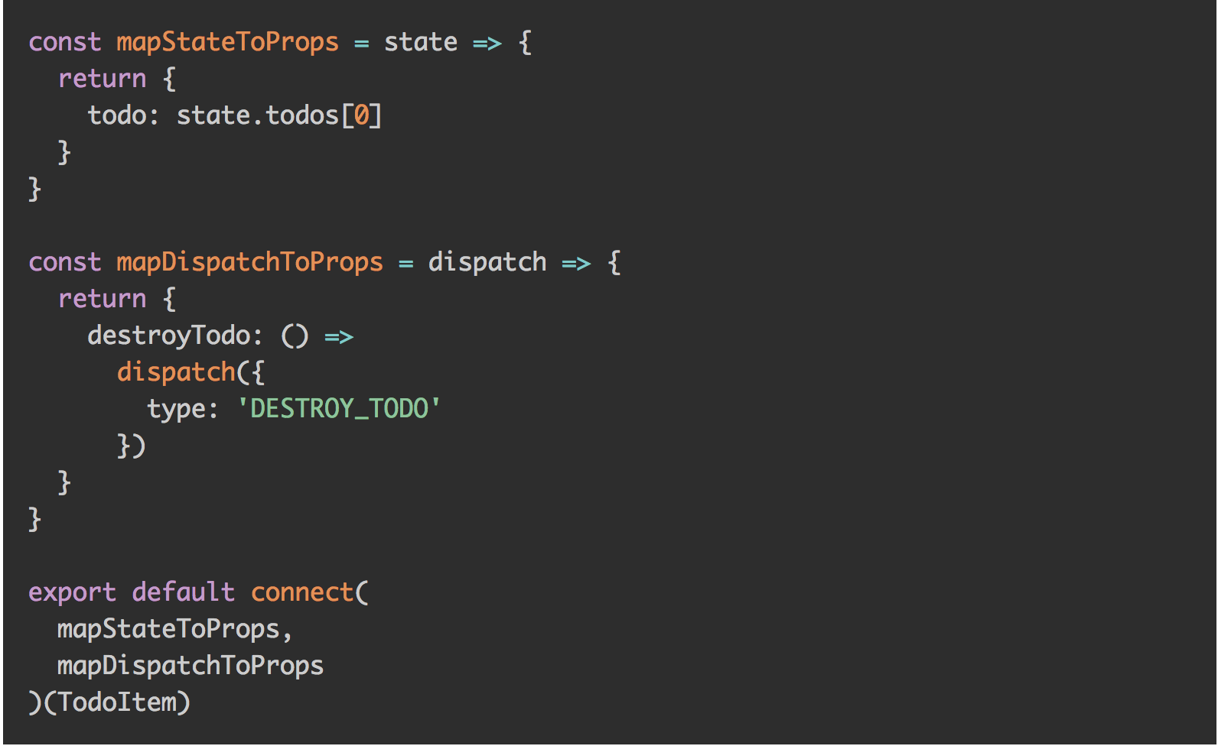
Connect

Slide 8
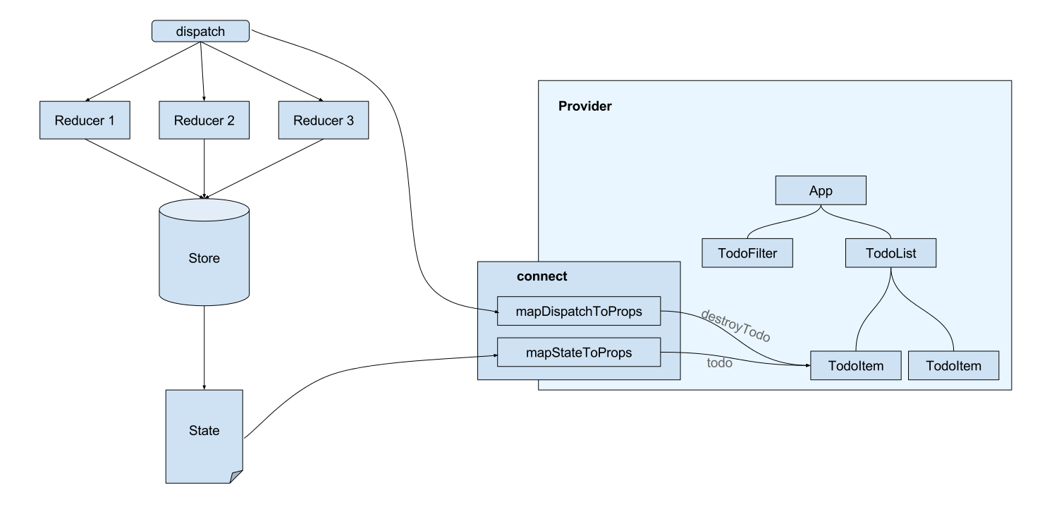
Whole picture

Slide 9
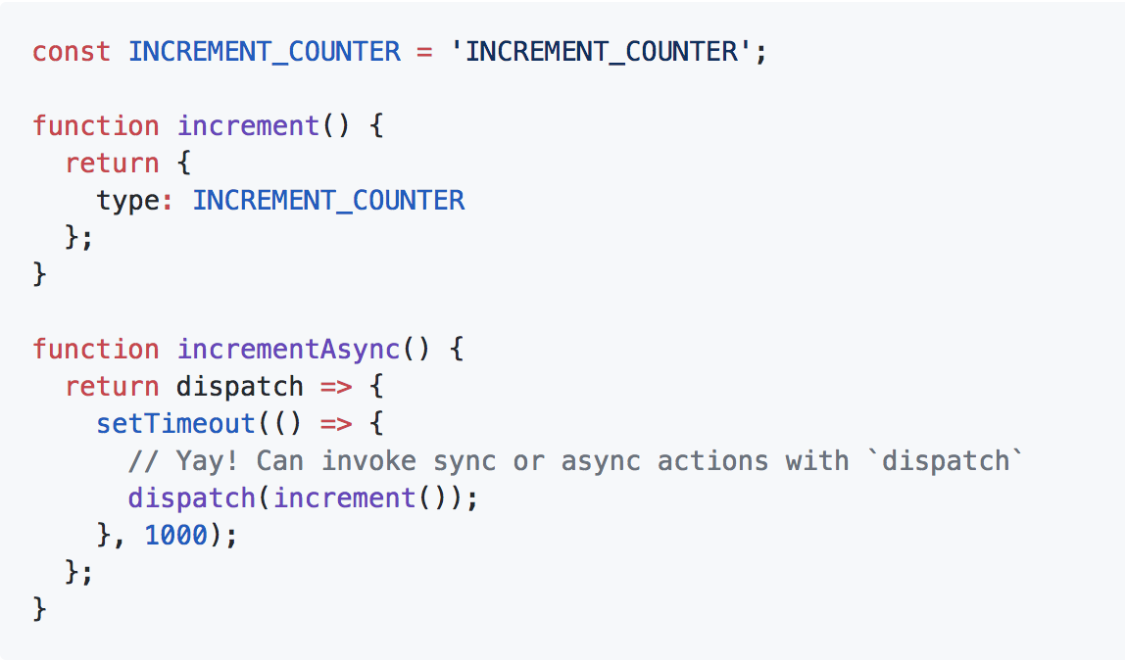
Redux Thunk

Slide 10
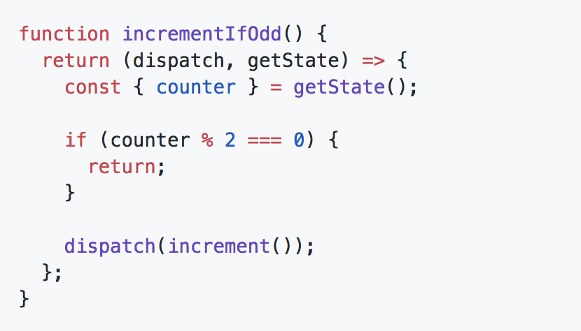
An action creator that returns a function to perform conditional dispatch

Slide 11
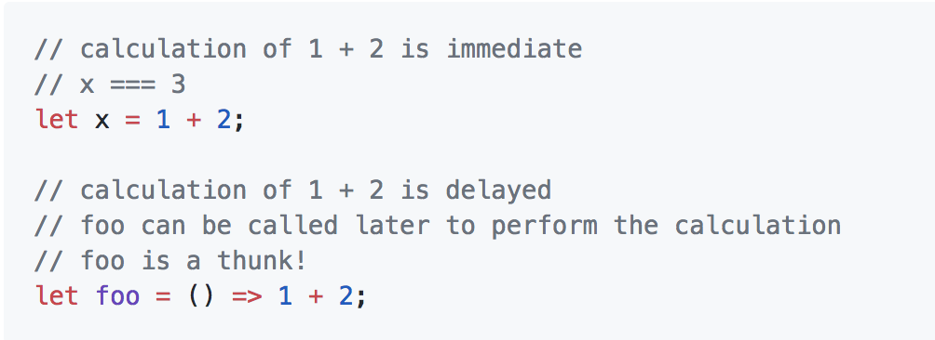
What’s a thunk?!

Slide 12
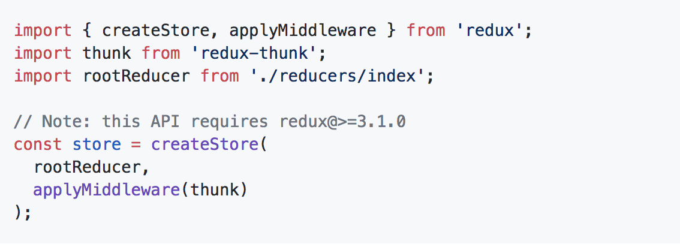
Apply thunk

Slide 13
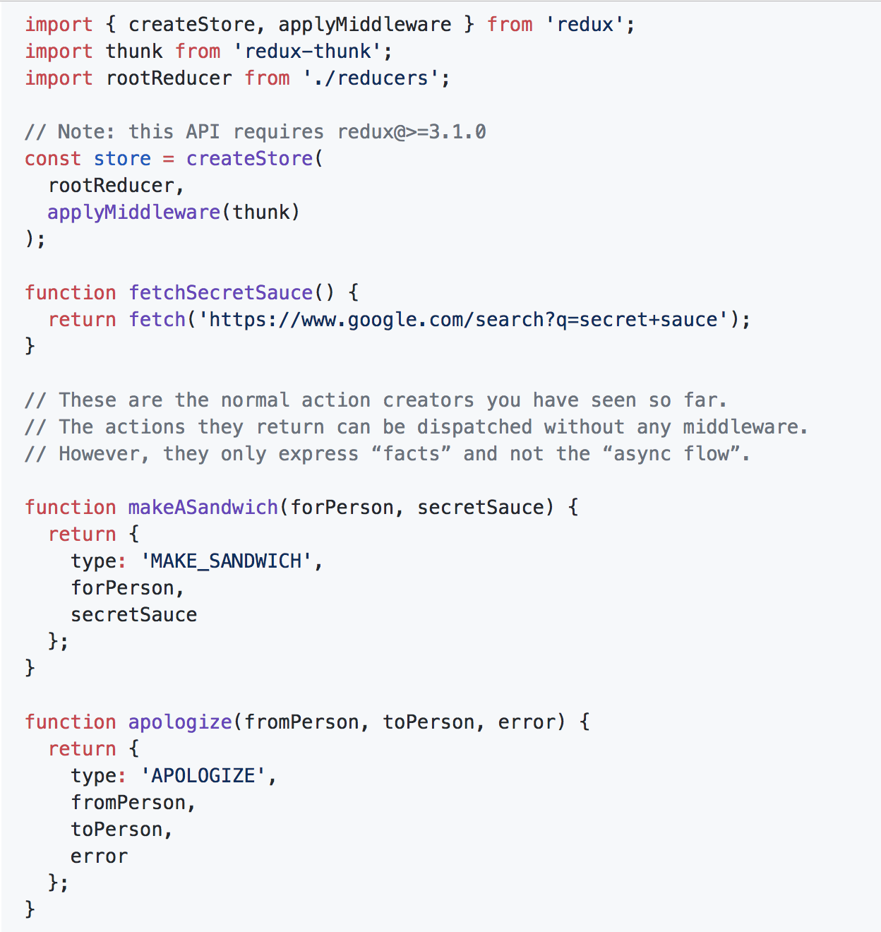
Apply

Slide 14
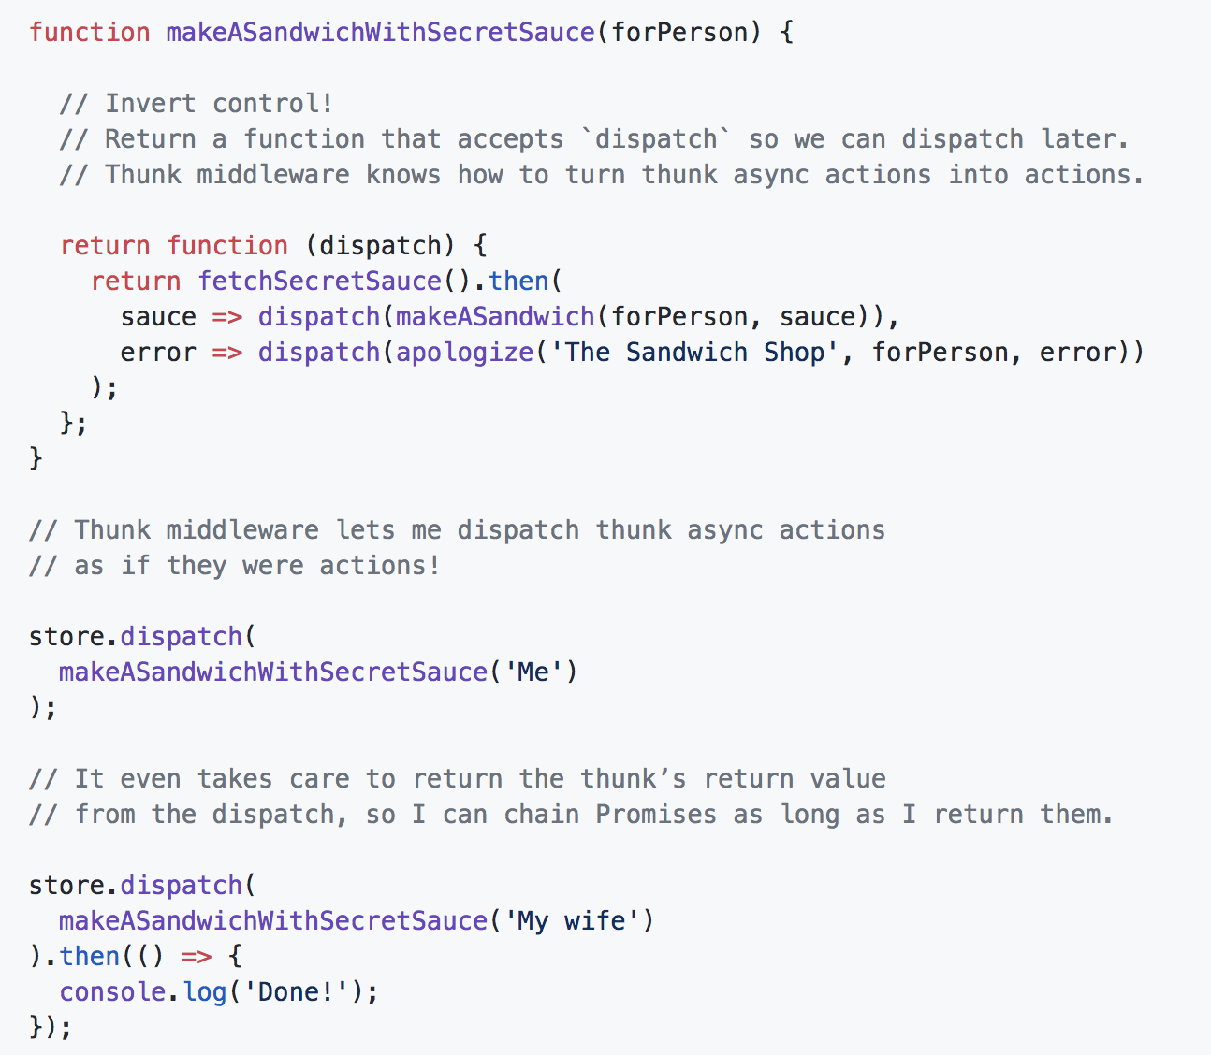
Apply thunk

Slide 15
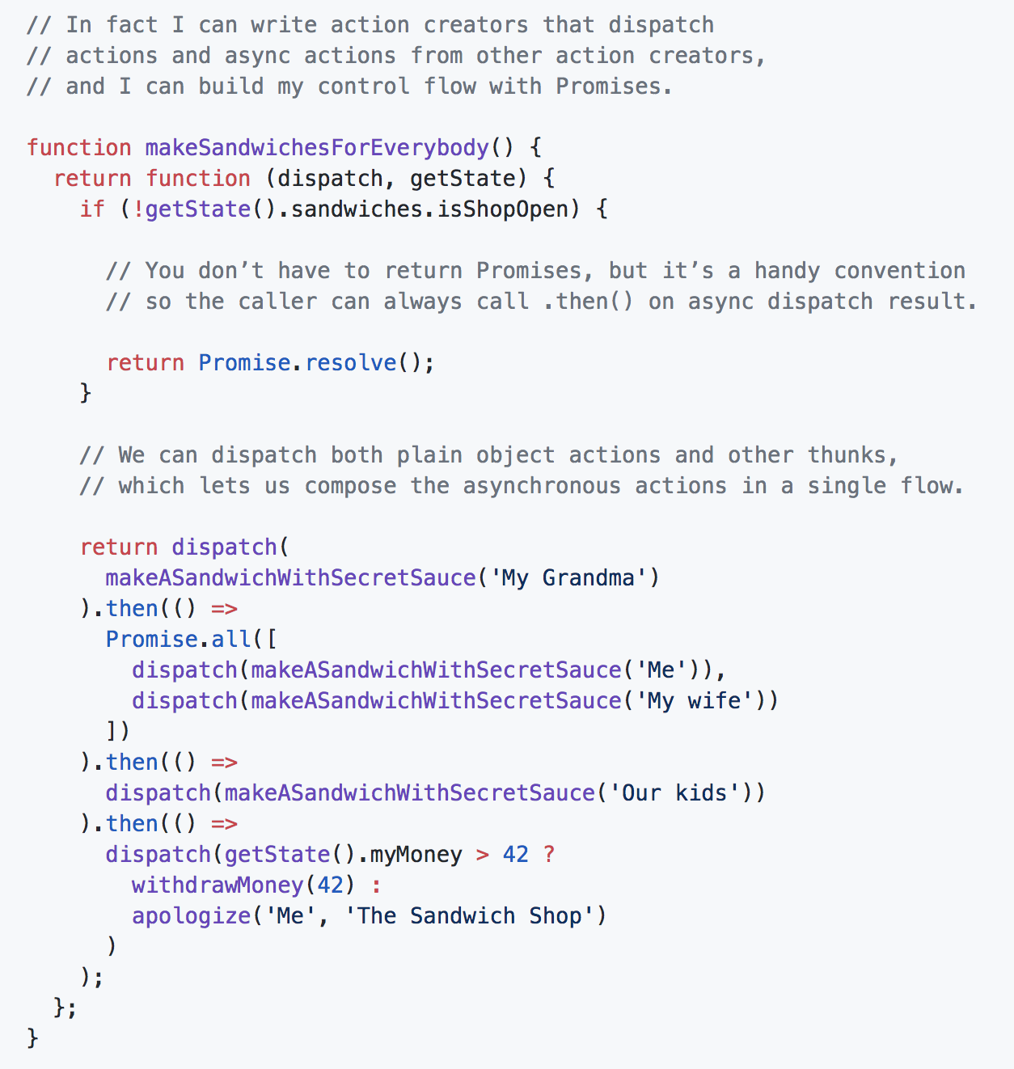
React Installation

Slide 16
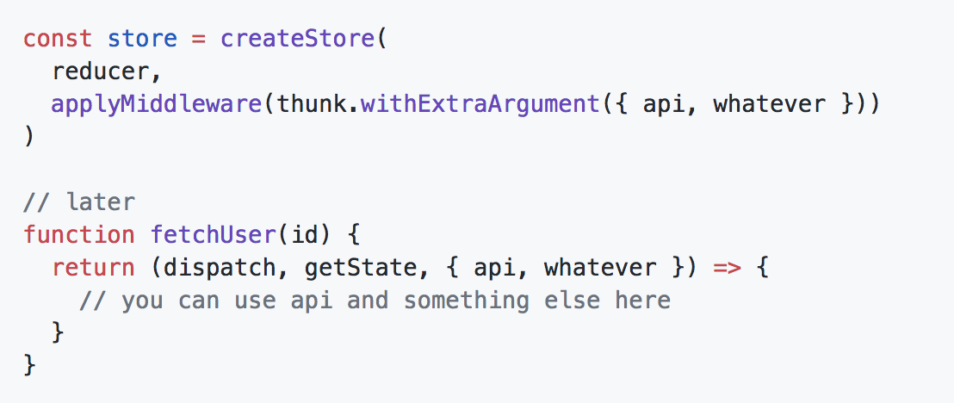
Pass multiple arguments

Slide 17
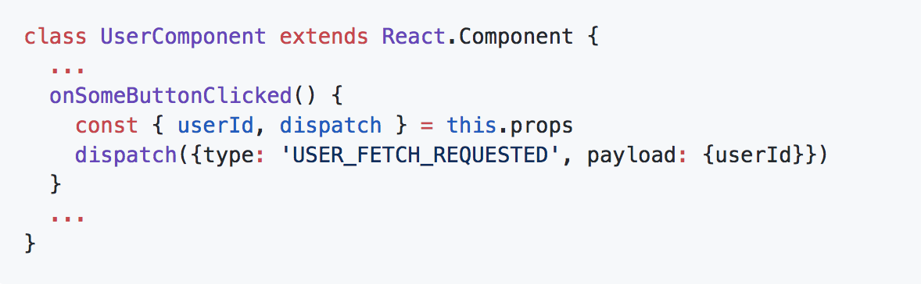
Redux-Saga

Slide 18
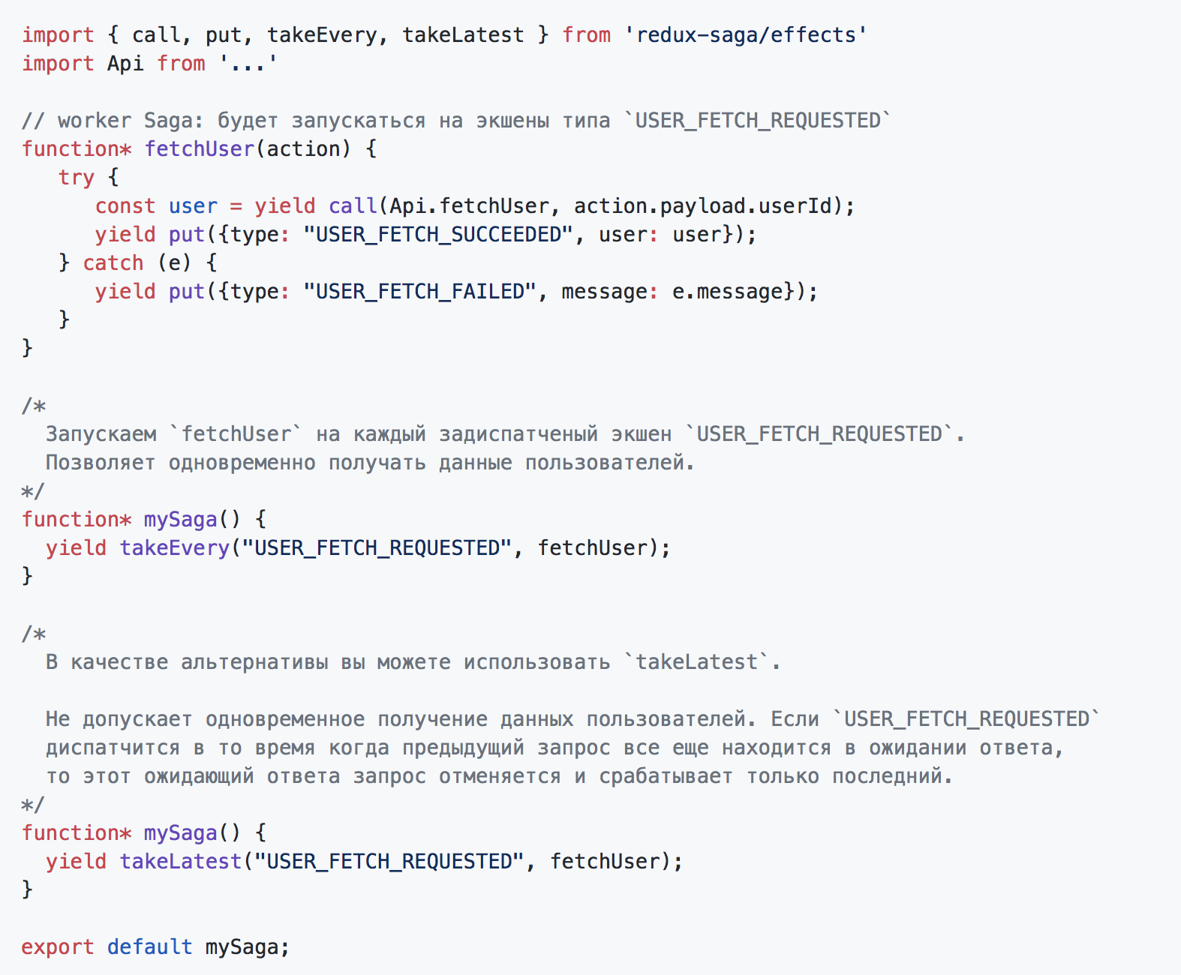
Redux-Saga in use

Slide 19
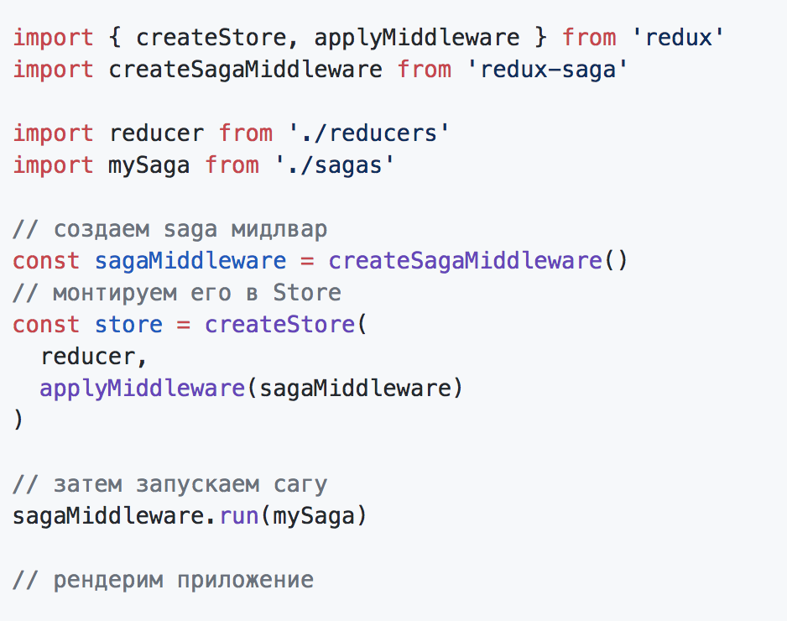
Apply Saga!

